Slide 1
Data Integration Pipelines for NYC Payroll Data Analytics
Data Engineering with Microsoft Azure
Amanda L

Slide 2
Important Notes
Serverless SQL pool in the Azure Synapse Analytics cannot be used as a sink.
Reference article: https://github.com/MicrosoftDocs/azure-docs/blob/main/articles/data-factory/data-flow-troubleshoot-connector-format.md
Mentors are not responding to my questions on this issue: https://knowledge.udacity.com/questions/984223
I have used up my free credits from my personal Azure account so using my personal account is not an ideal solution.
I took the liberty to replace the sink with SQL Database instead and the pipelines succeeded without issues.
I was also unable to create an empty external table in Azure Synapse serverless SQL pool.
SQL database will be used as a replacement for the sink for aggregation pipeline.
Unanswered question: https://knowledge.udacity.com/questions/984355

Slide 3
Step 1
Prepare the Data Infrastructure

Slide 4
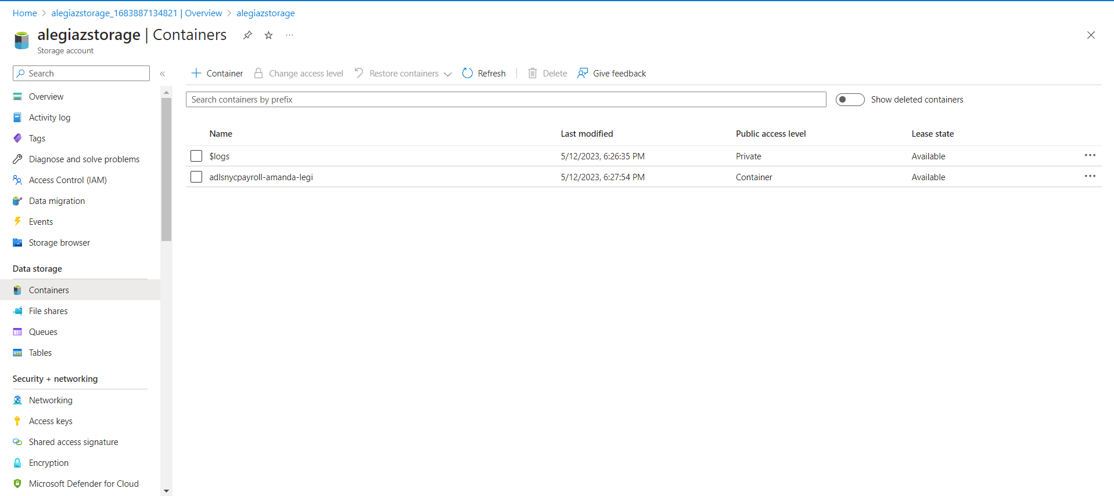
1.Create the data lake and upload data

Slide 5
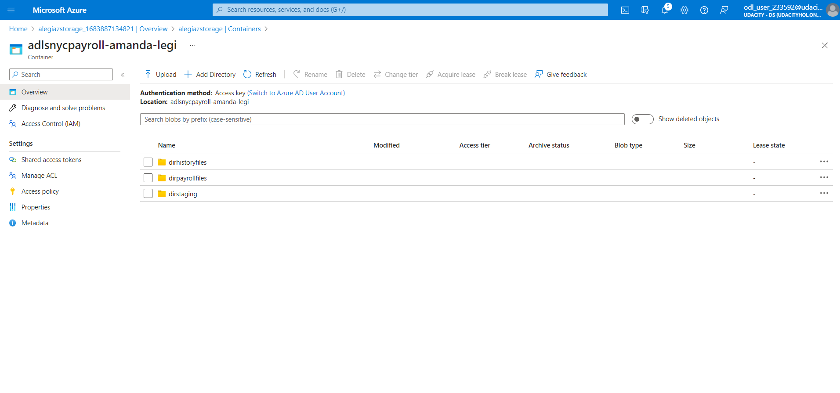

Slide 6
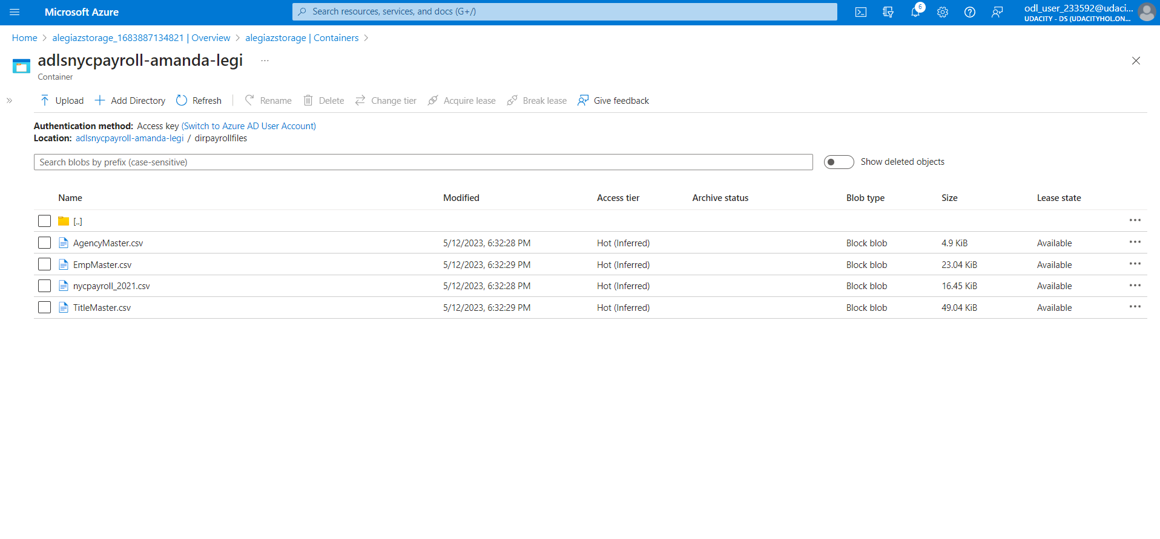

Slide 7
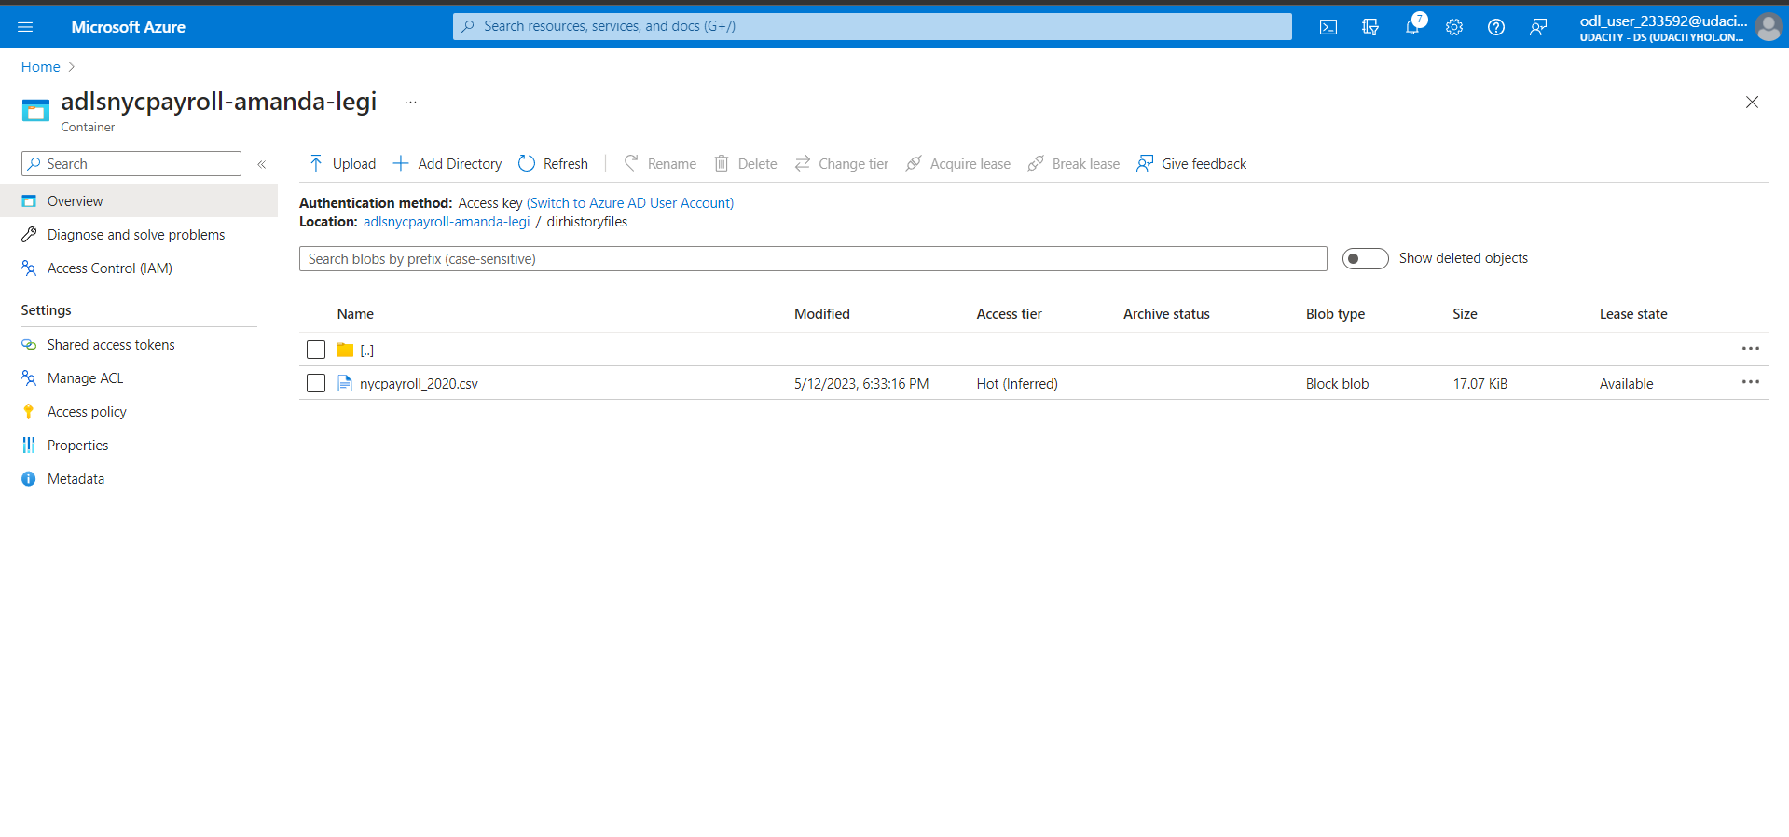

Slide 8
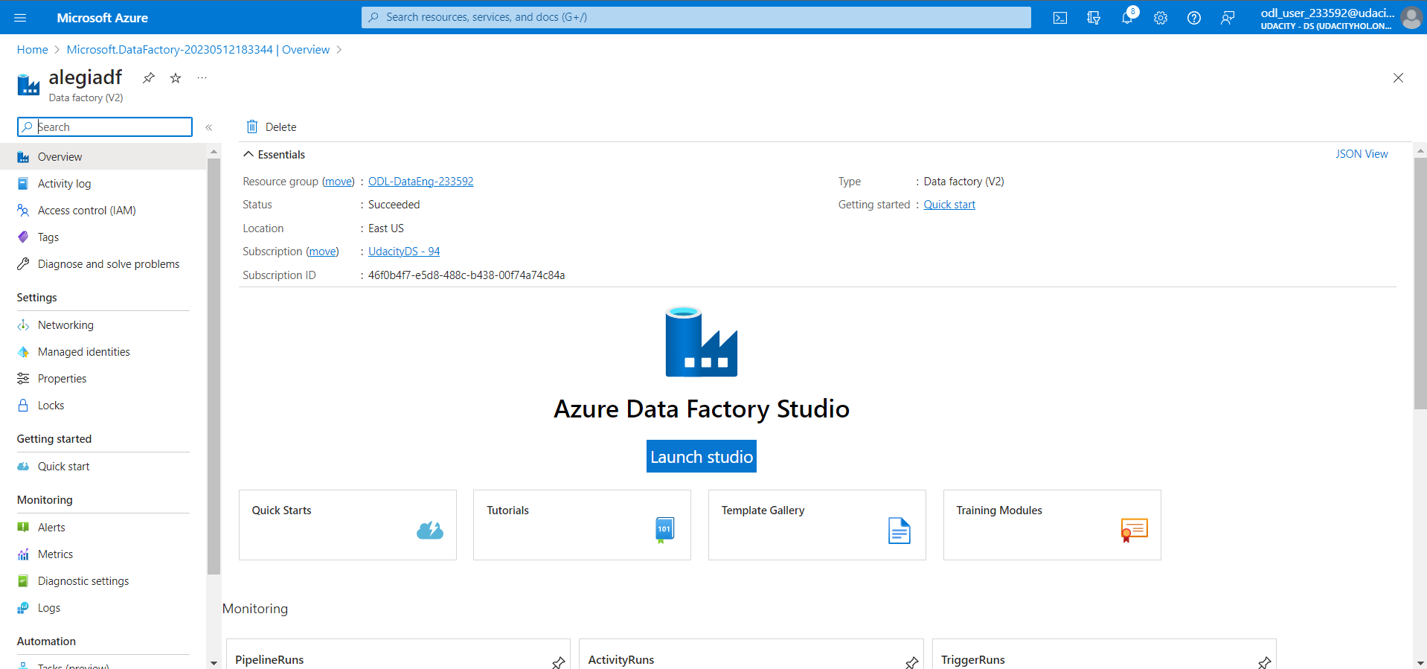
2. Create an Azure Data Factory Resource

Slide 9
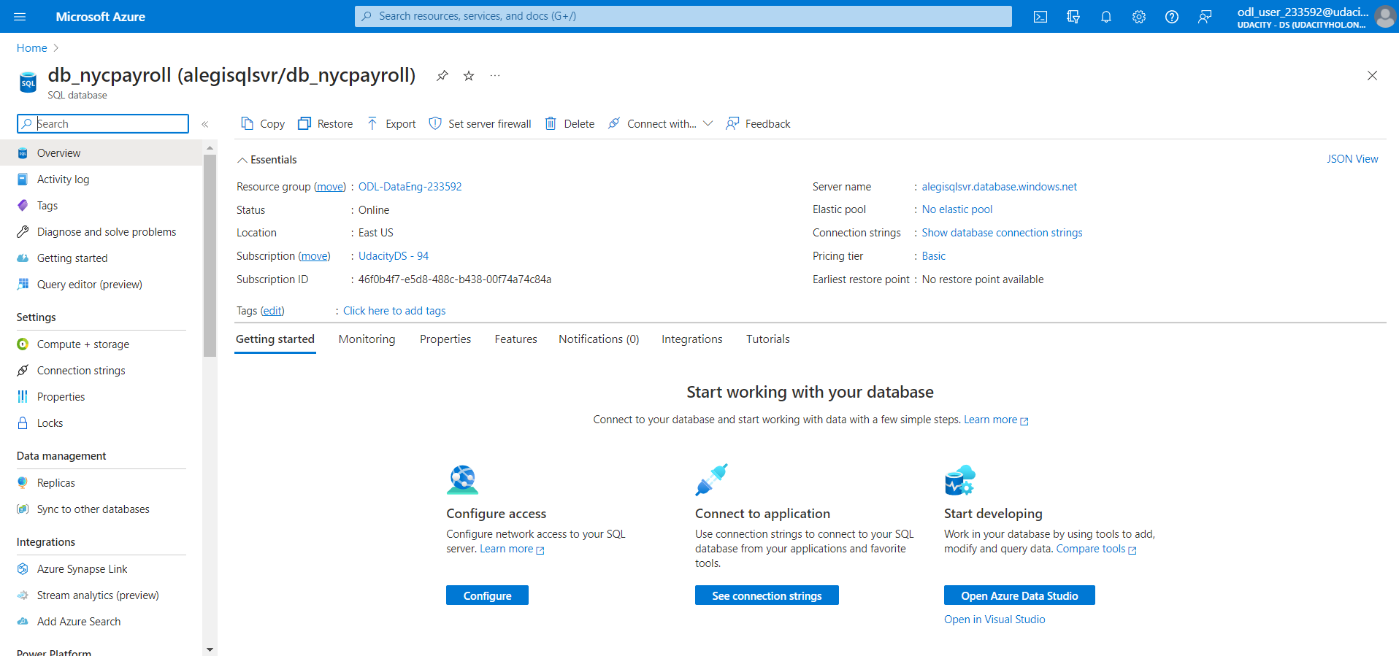
3. Create a SQL Database to store the current year of the payroll data

Slide 10
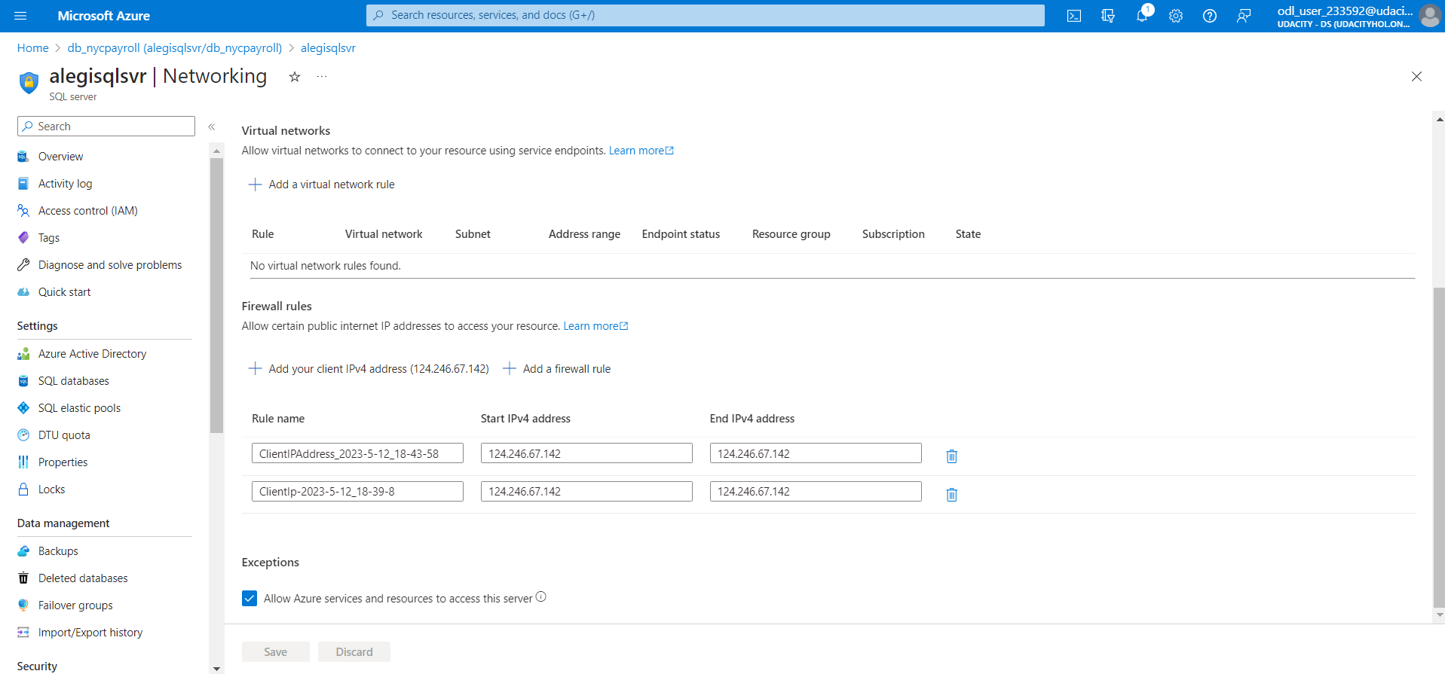

Slide 11
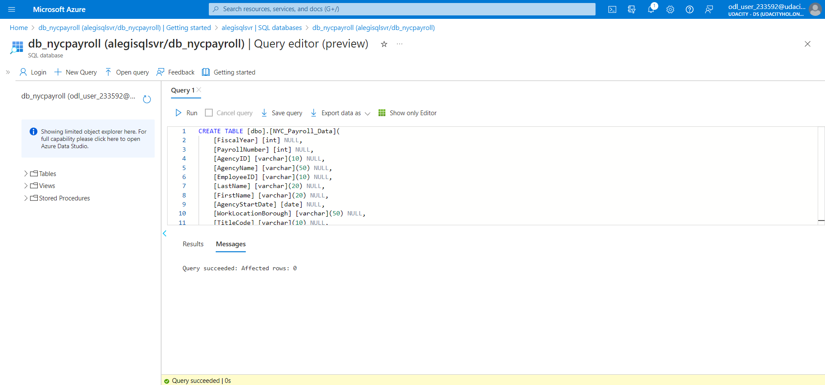

Slide 12
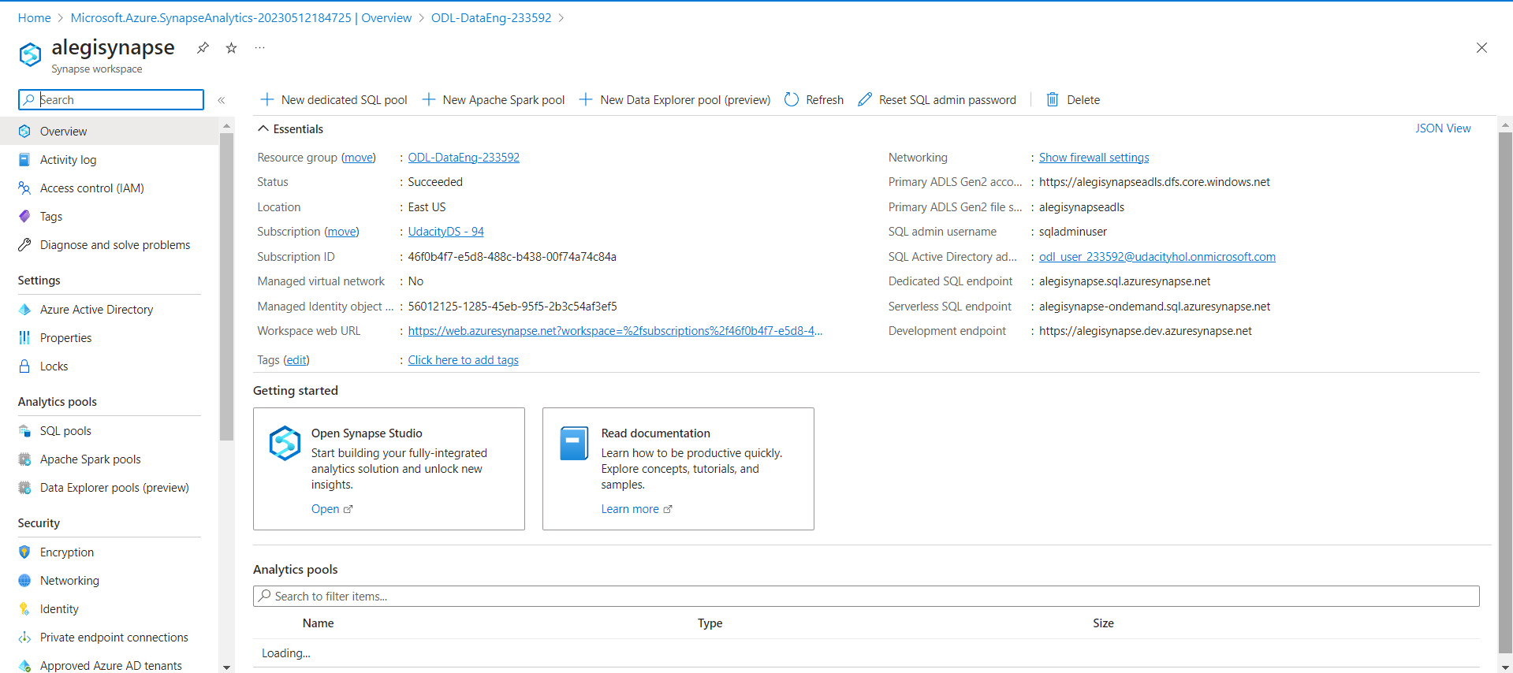
4. Create a Synapse Analytics workspace

Slide 13
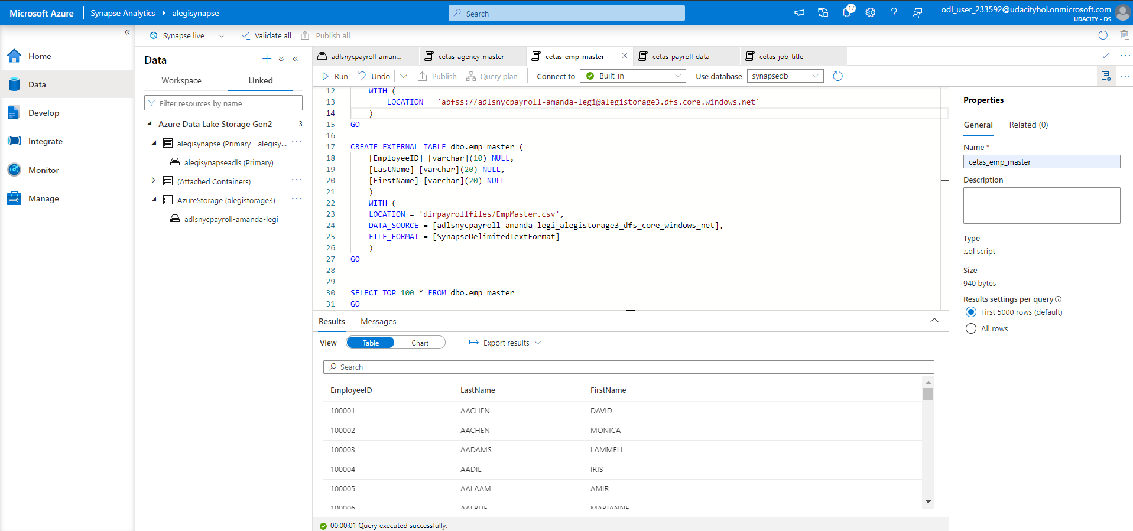
5. Create master data tables and payroll transaction tables in Synapse Analytics workspace

Slide 14
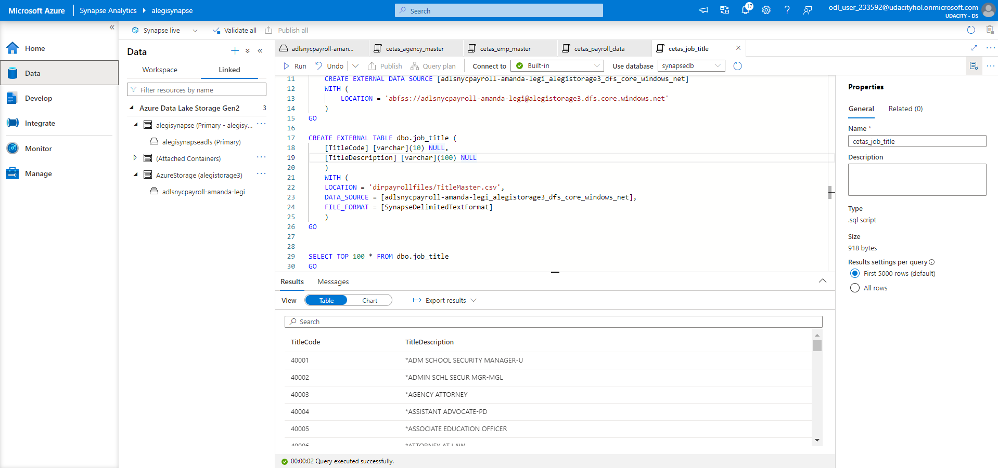

Slide 15
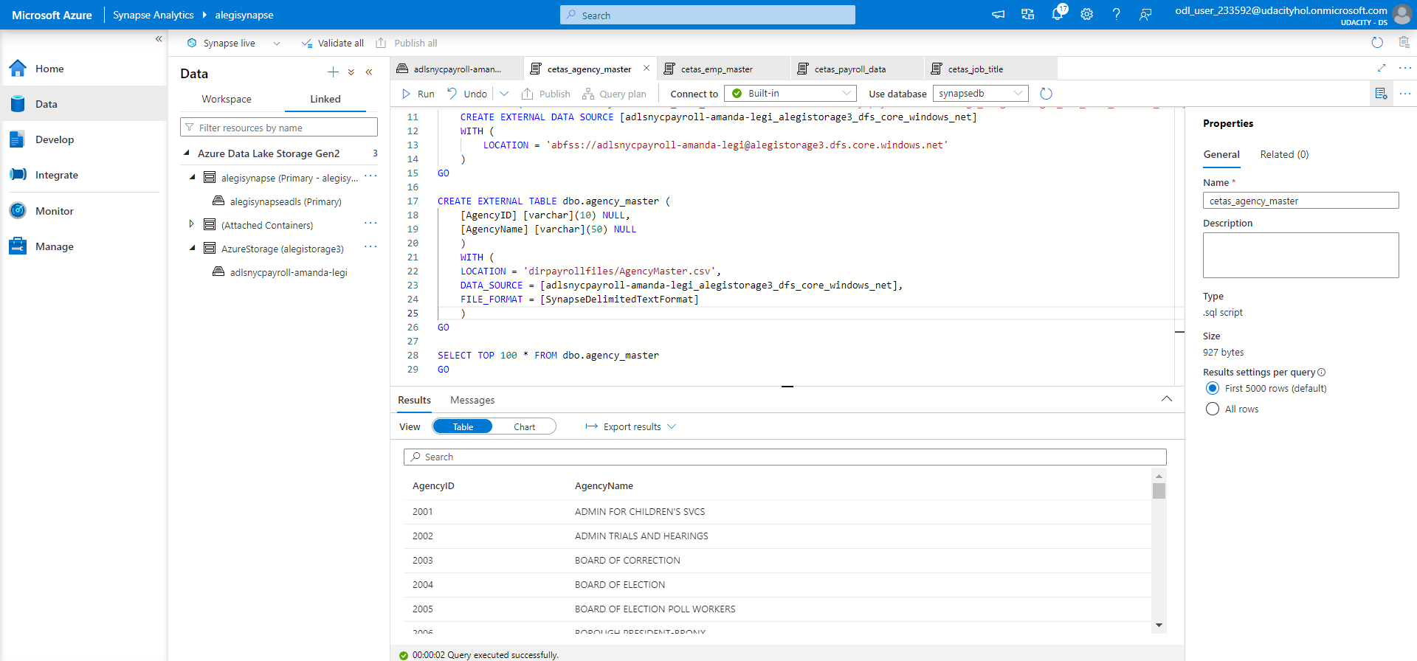

Slide 16
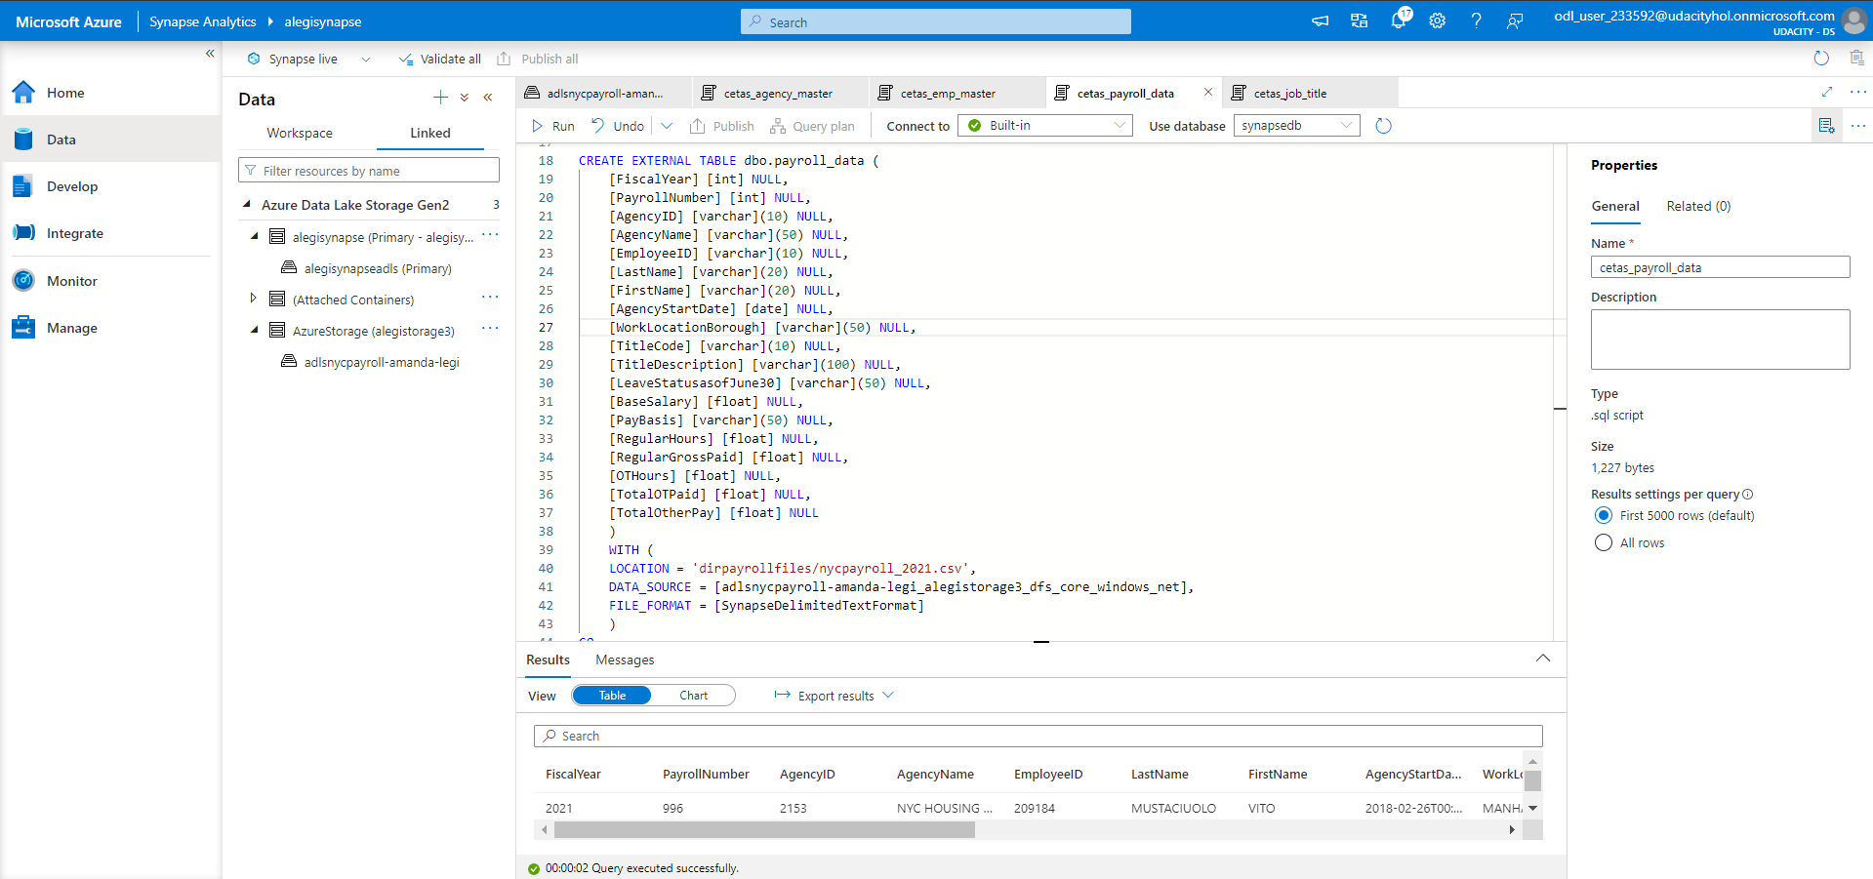

Slide 17
Step 2
Create Linked Services in Azure Data Factory

Slide 18
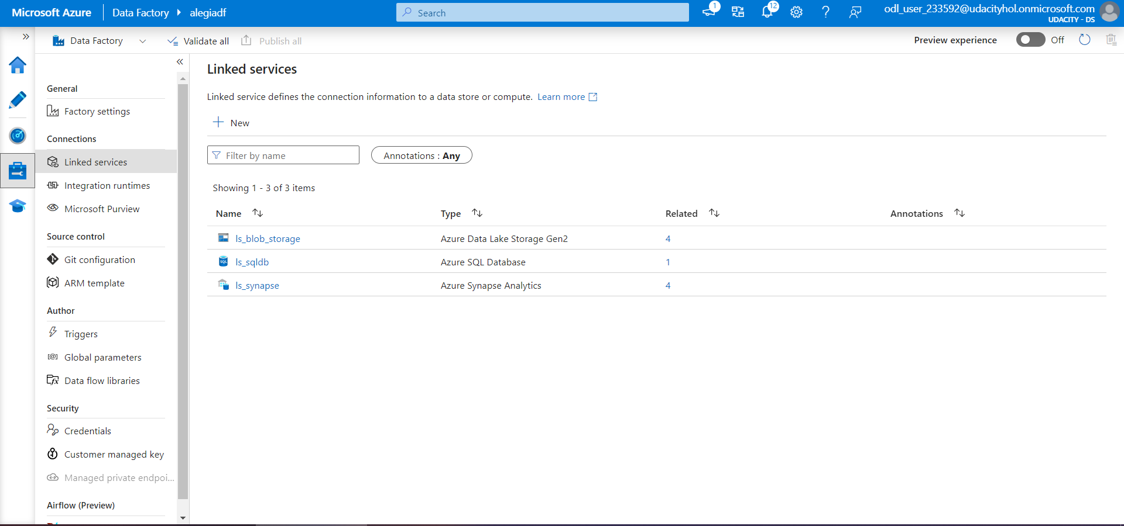

Slide 19
Step 3
Create Datasets in Azure Data Factory

Slide 20
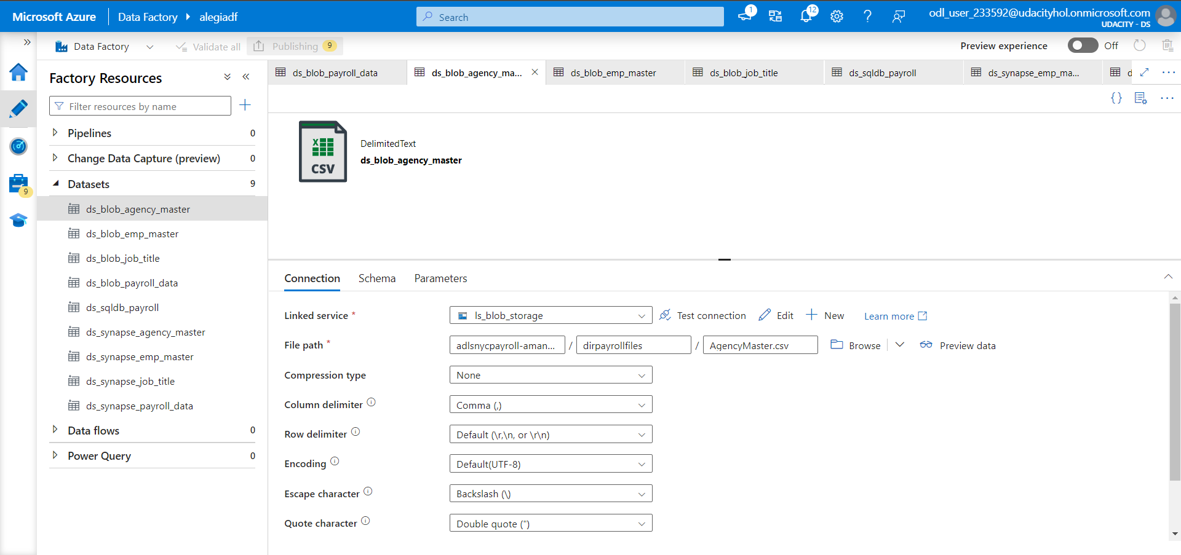

Slide 21
Step 4
Create Data Flows and Pipelines

Slide 22
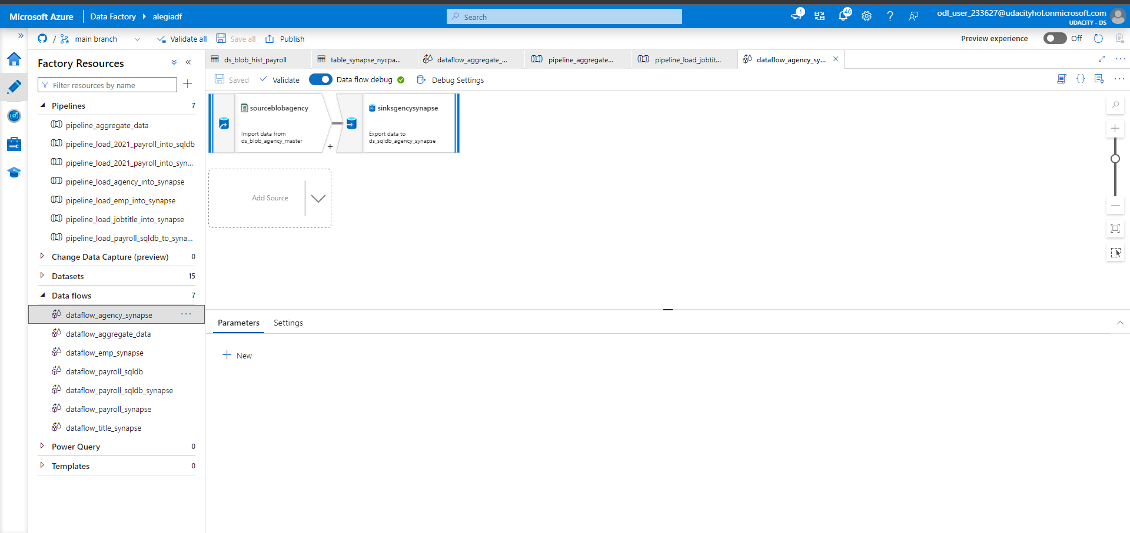

Slide 23
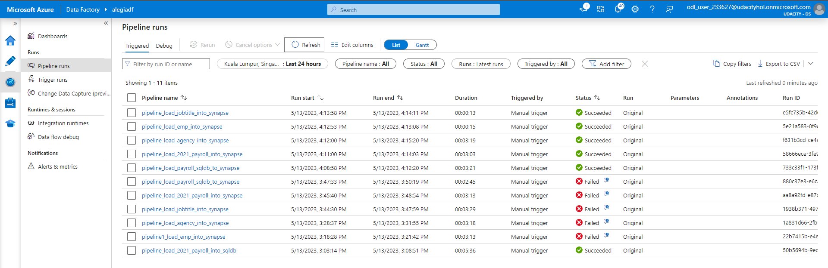
Serverless SQL pool in the Azure Synapse Analytics cannot be used as a sink.
Reference article: https://github.com/MicrosoftDocs/azure-docs/blob/main/articles/data-factory/data-flow-troubleshoot-connector-format.md
Mentors are not responding to my questions on this issue: https://knowledge.udacity.com/questions/984223
I have used up my free credits from my personal Azure account so using my personal account is not an ideal solution.
I took the liberty to replace the sink with SQL Database instead and the pipelines succeeded without issues.

Slide 24
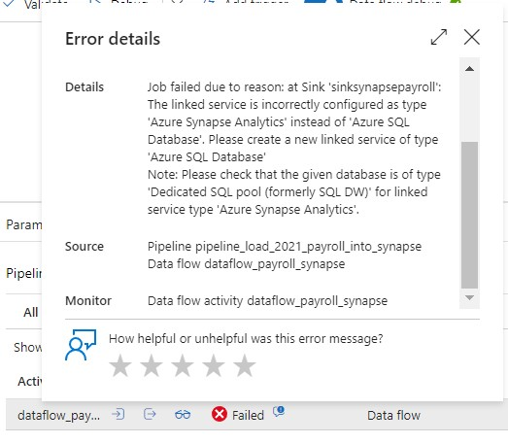
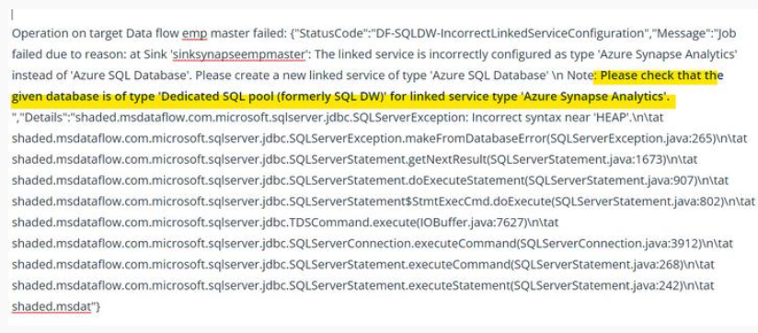
Error messages encountered when loading data into external tables in Synapse serverless SQL pool

Slide 25
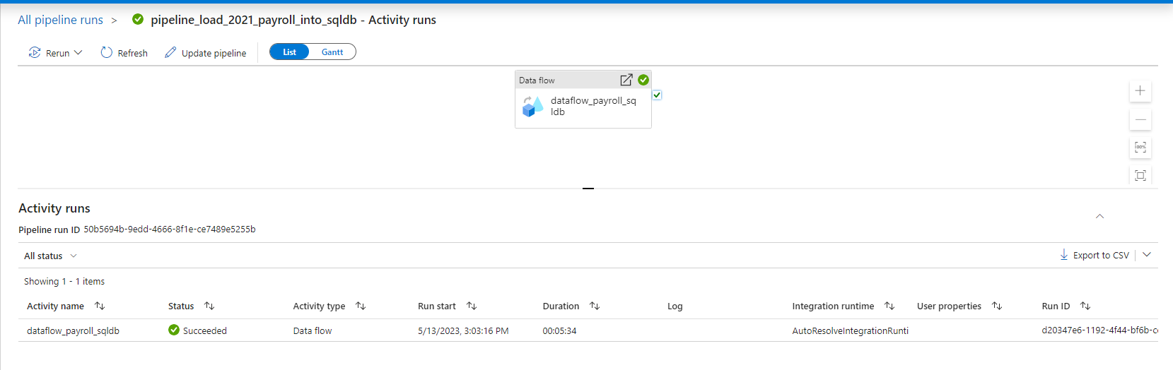
Successful pipeline run for loading 2021 payroll data from data lake into SQL database

Slide 26
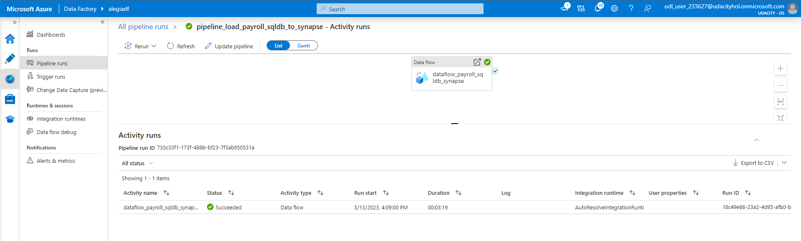
Successful pipeline run for loading 2021 payroll data from SQL database into Synapse sink replacement (SQL database)

Slide 27
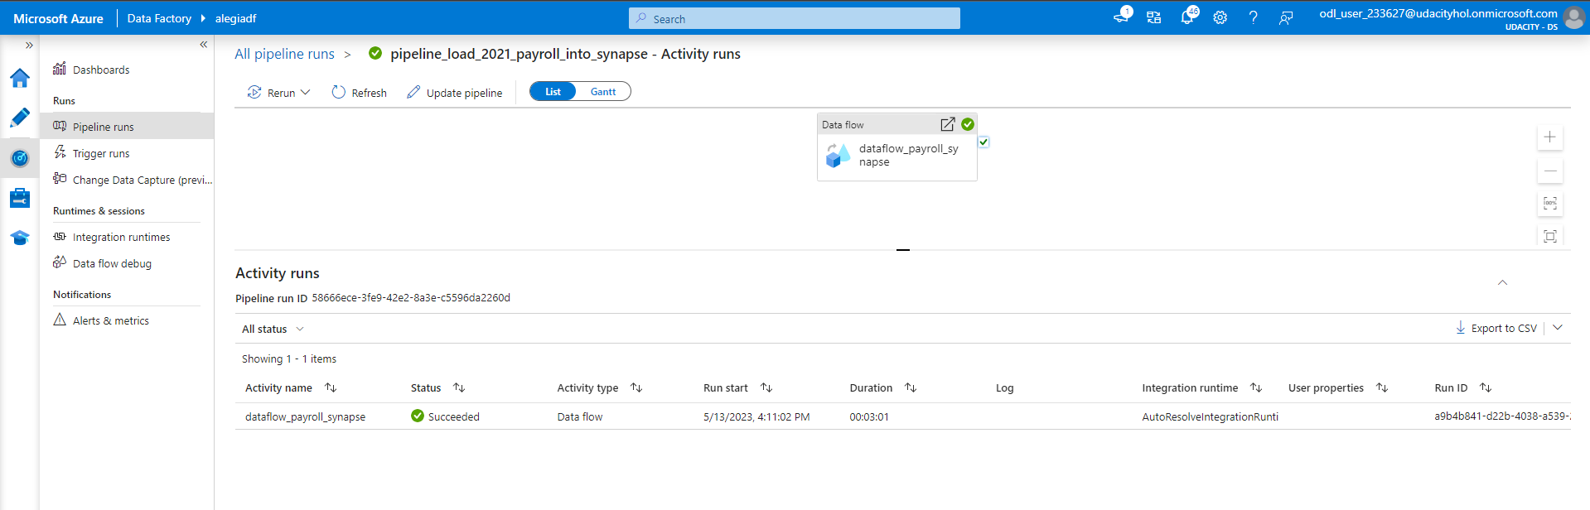
Successful pipeline run for loading 2021 payroll data from data lake into Synapse sink replacement (SQL database)

Slide 28
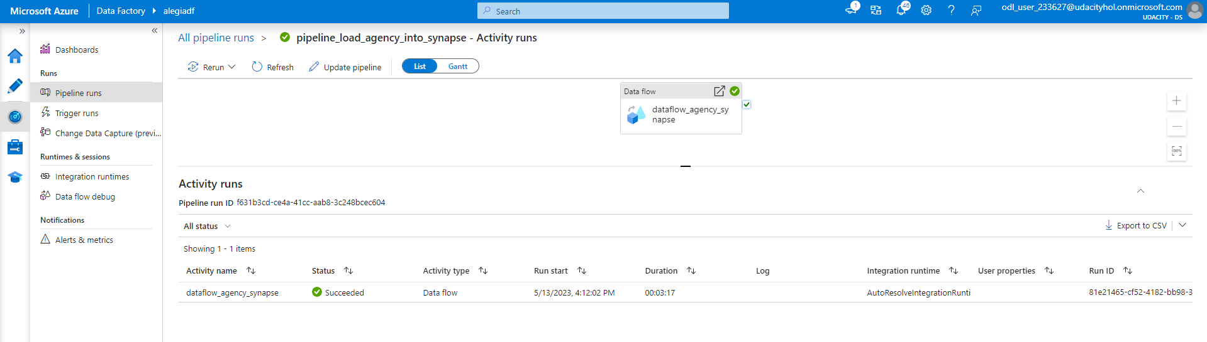
Successful pipeline run for loading agency master data from data lake into Synapse sink replacement (SQL database)

Slide 29
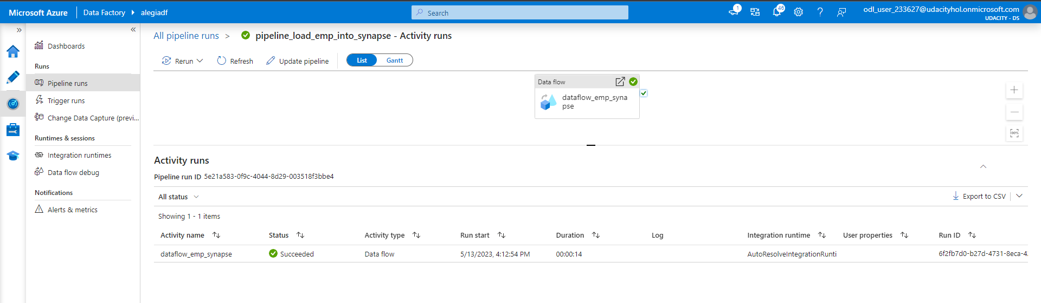
Successful pipeline run for loading emp master from data lake into Synapse sink replacement (SQL database)

Slide 30

Successful pipeline run for loading job title from data lake into Synapse sink replacement (SQL database)

Slide 31
Step 5
Data Aggregation and Parameterization

Slide 32
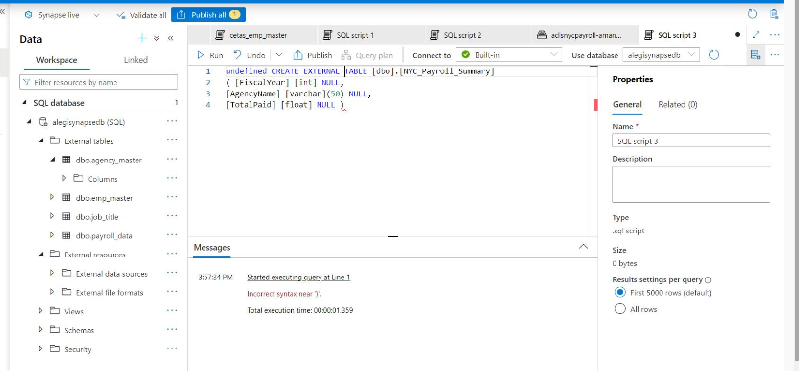
Unable to create an empty external table in Azure Synapse serverless SQL pool.
SQL database will be used as a replacement.
Unanswered question: https://knowledge.udacity.com/questions/984355

Slide 33
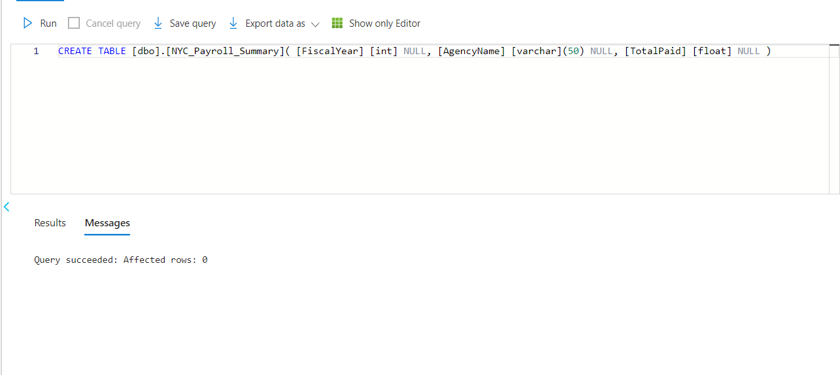
1.Create a Summary table in Synapse (replaced with SQL database) with the following SQL script and create a dataset named table_synapse_nycpayroll_summary

Slide 34
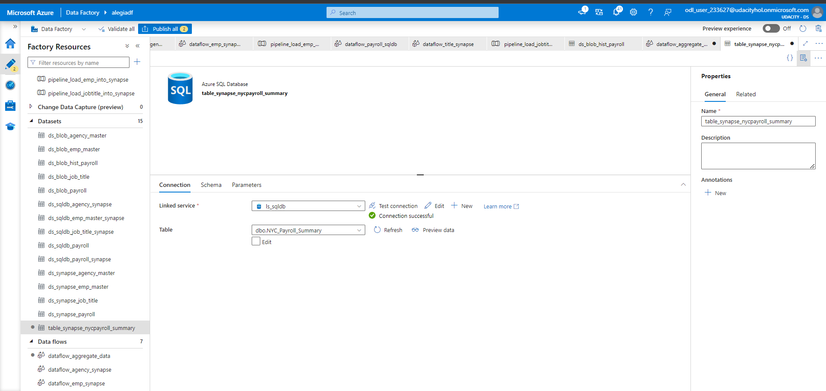

Slide 35
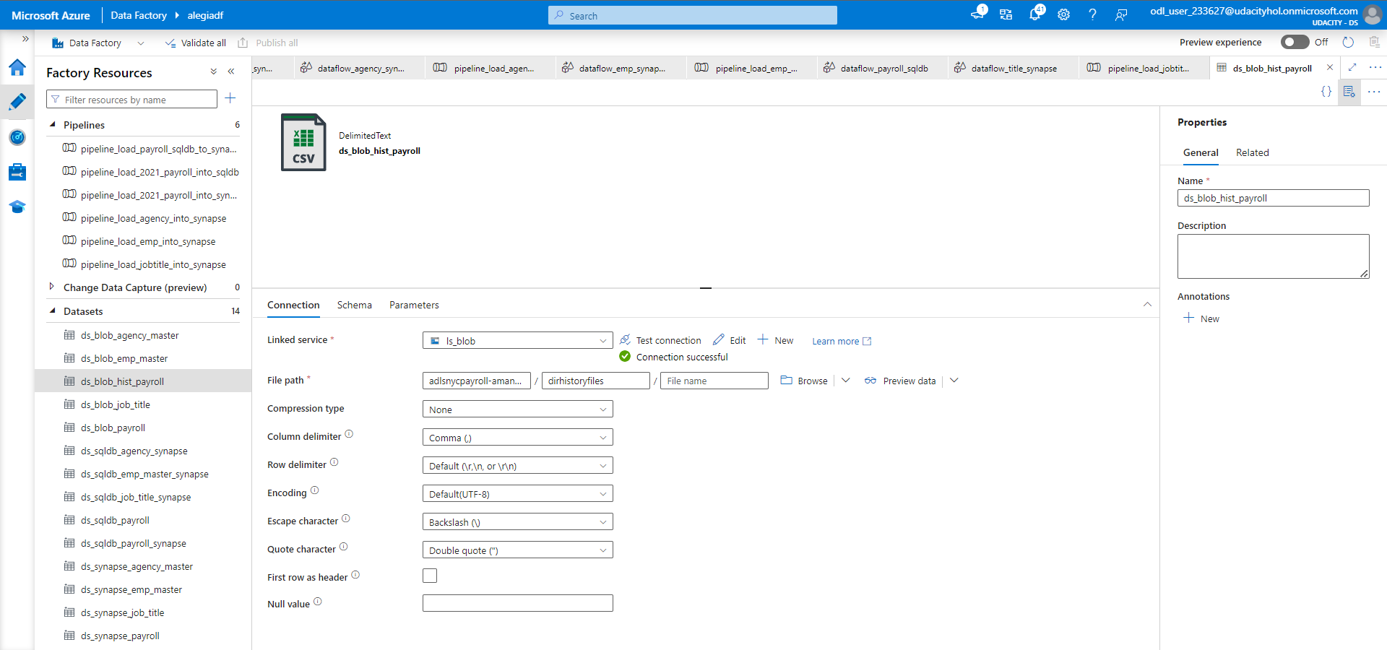
2.Create a new dataset for the Azure Data Lake Gen2 folder that contains the historical files.

Slide 36
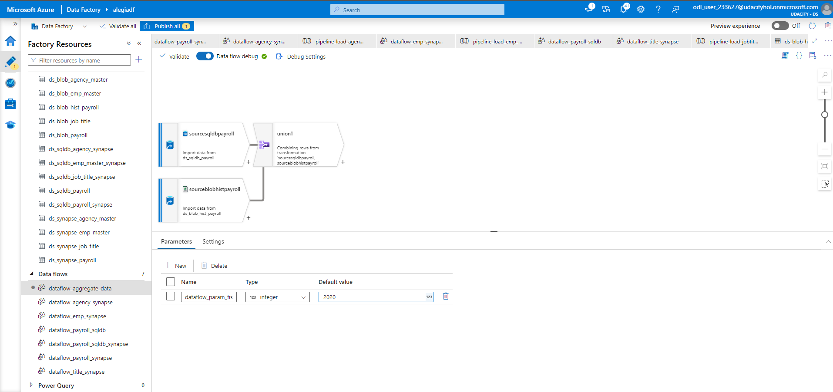
3.Create new data flow and name it Dataflow Aggregate Data

Slide 37
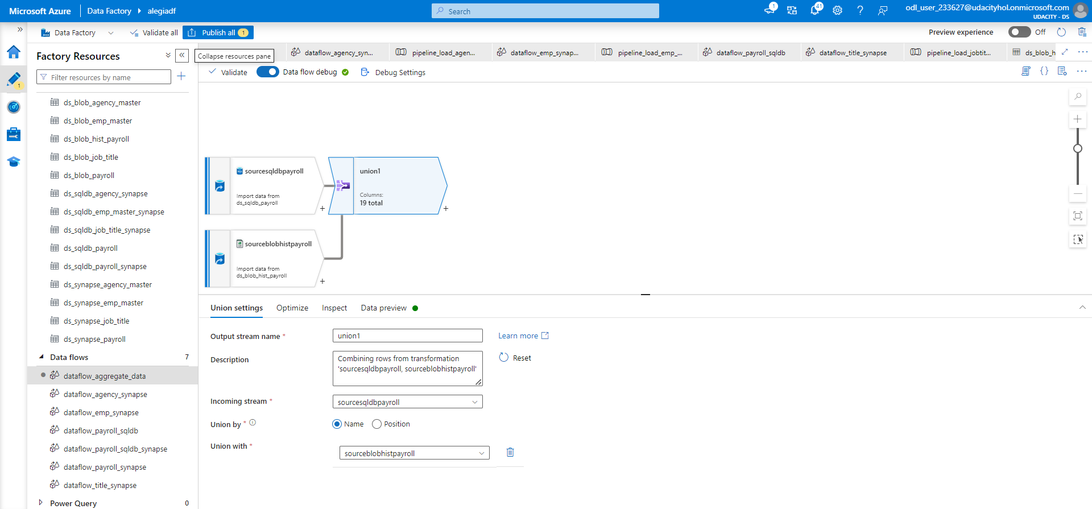
4.Create a new Union activity in the data flow and Union with history files

Slide 38
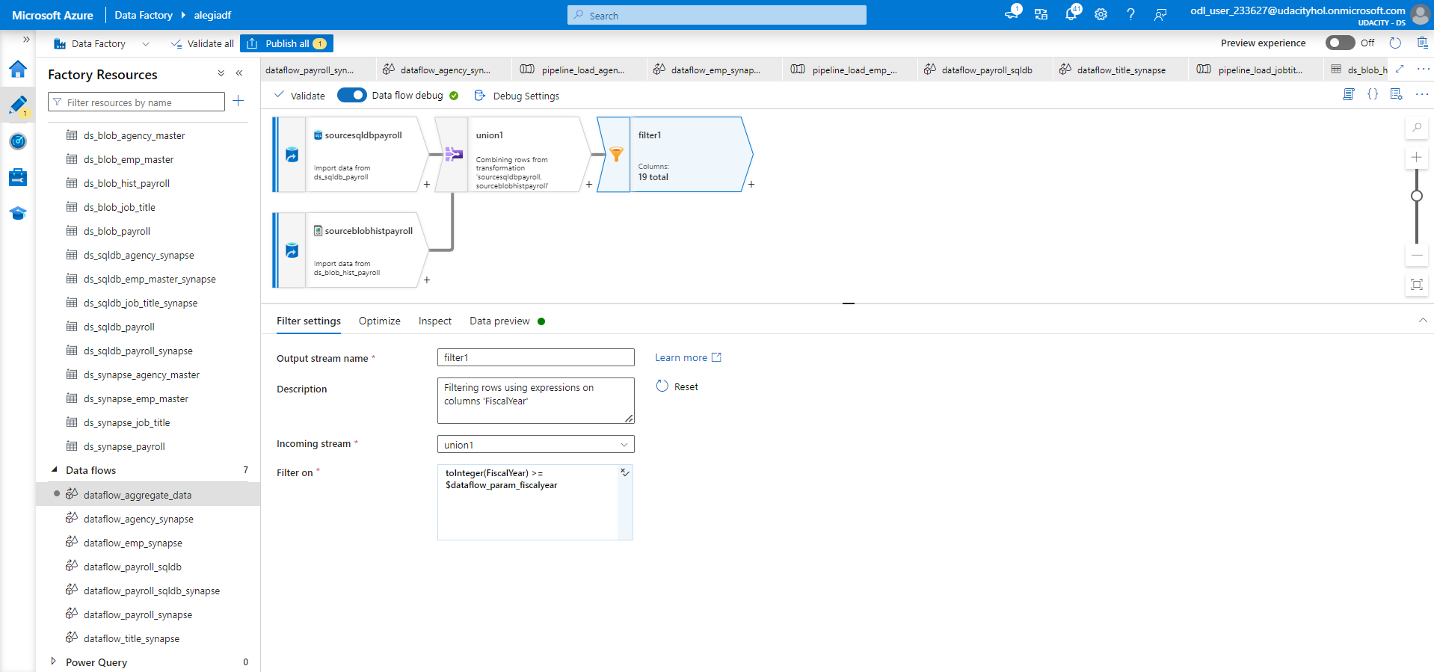
5.Add a Filter activity after Union

Slide 39
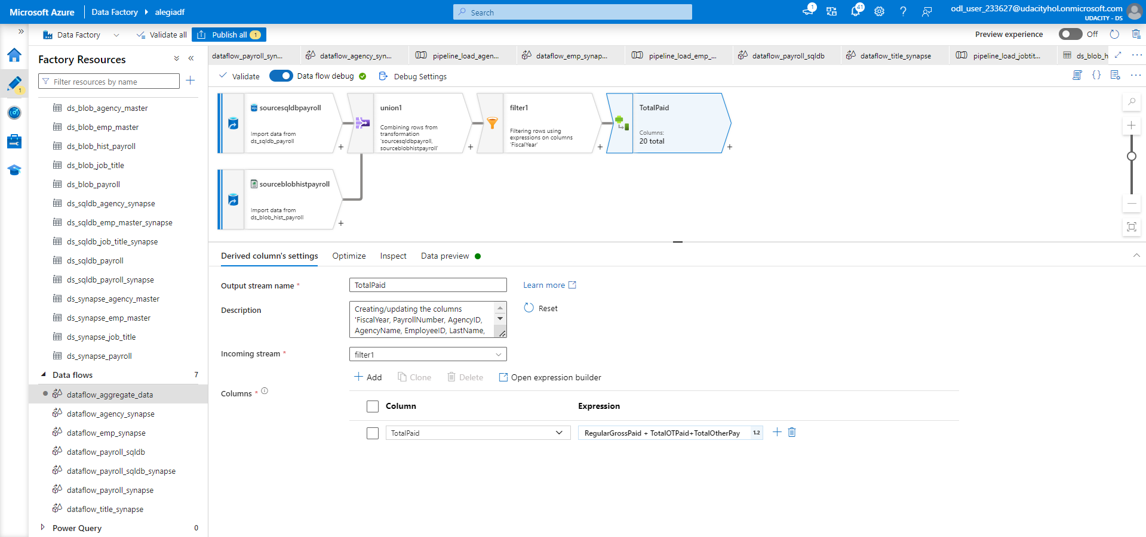
6.Derive a new TotalPaid column

Slide 40
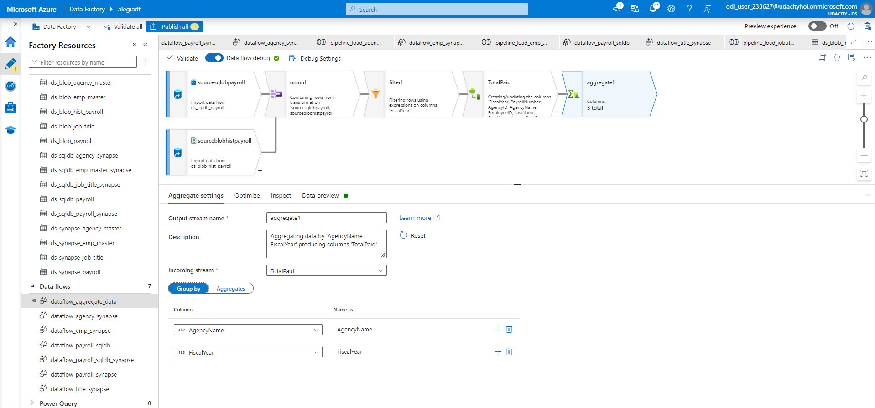
7.Add an Aggregate activity to the data flow next to the TotalPaid activity

Slide 41
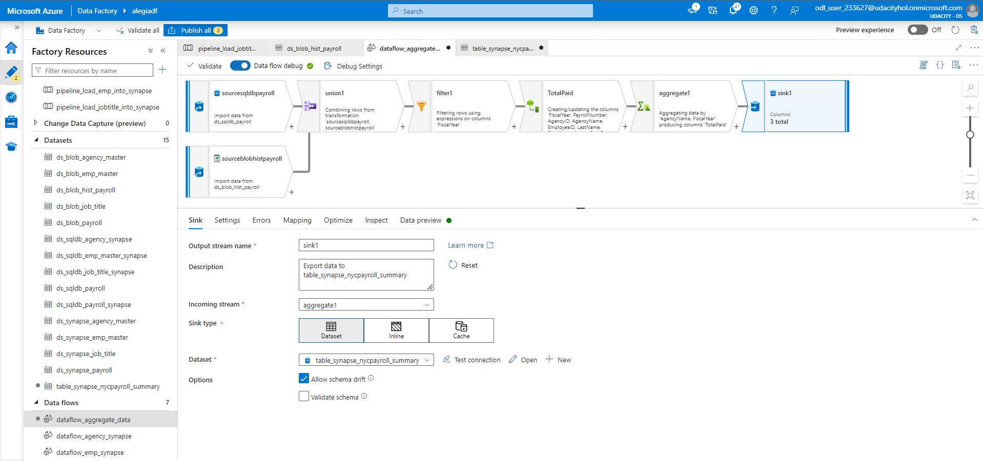
8.Add a Sink activity to the Data Flow

Slide 42
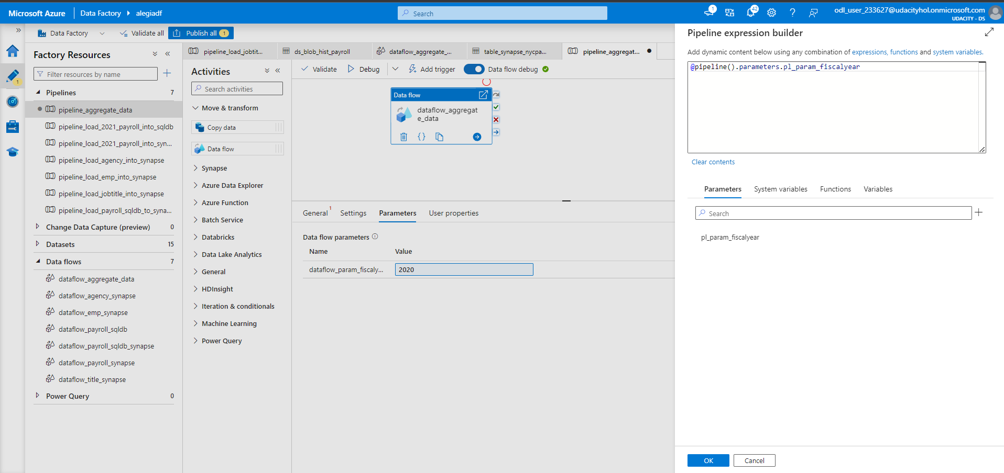
9.Create a new Pipeline and add the Aggregate data flow

Slide 43
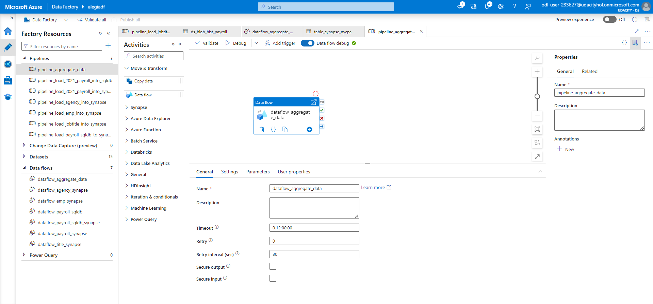
10.Validate, Publish and Trigger the pipeline. Enter the desired value for the parameter.

Slide 44
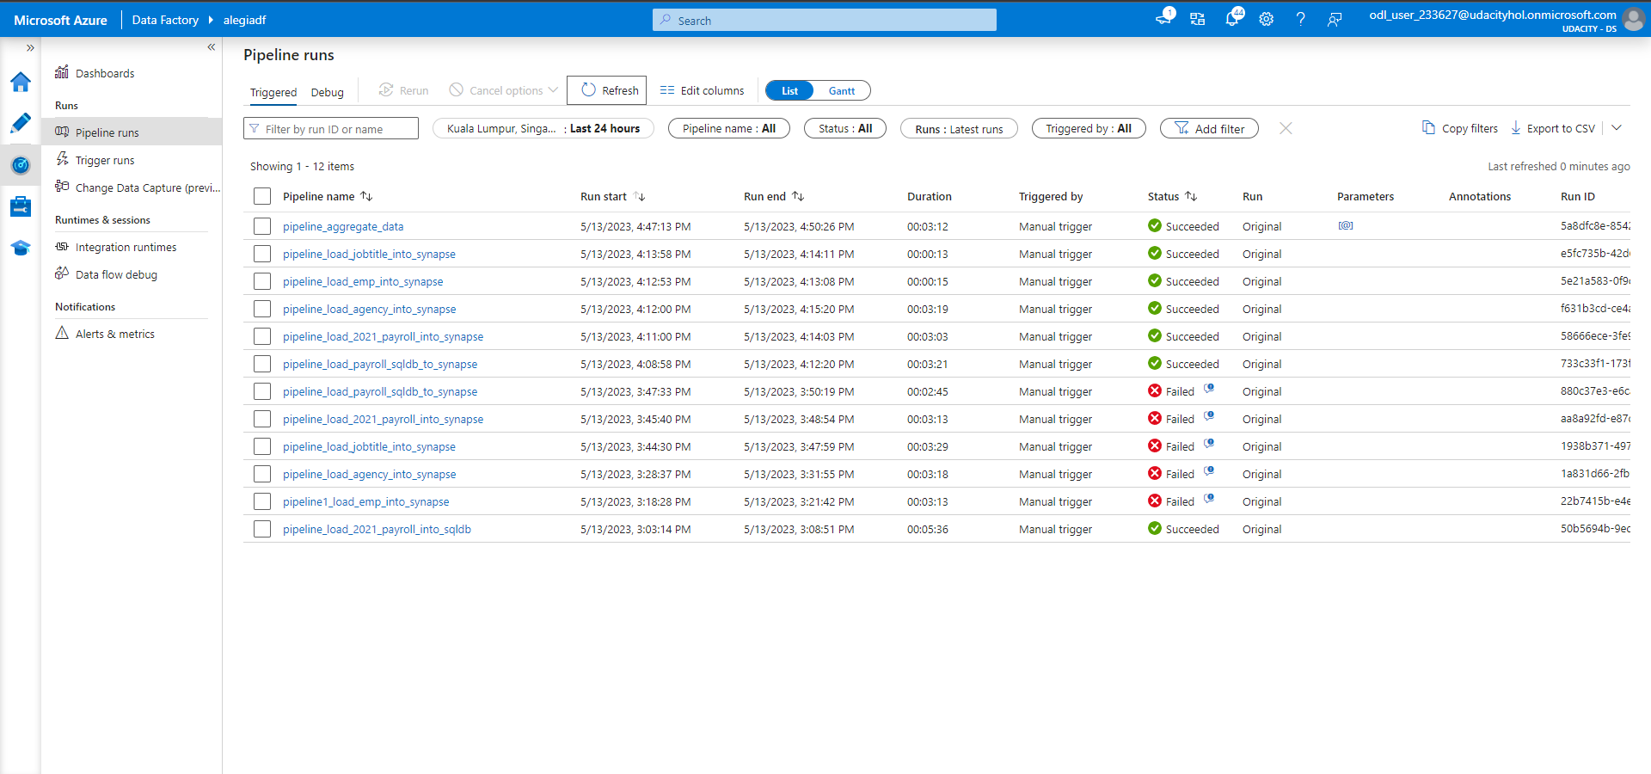
11.Monitor the Pipeline run and take a screenshot of the finished pipeline run.

Slide 45
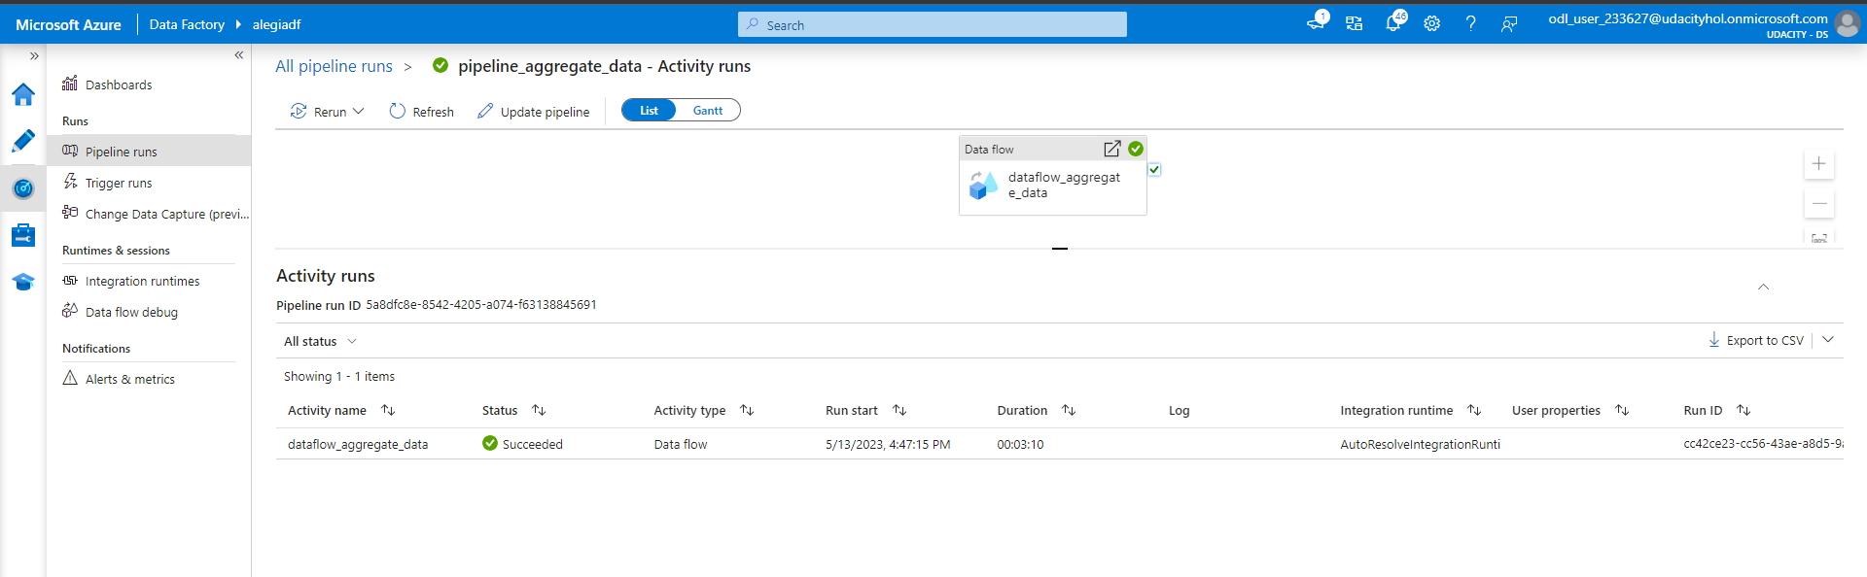
Successful aggregate pipeline run

Slide 46
Step 6
Connect Project to Github

Slide 47
